Slide 1
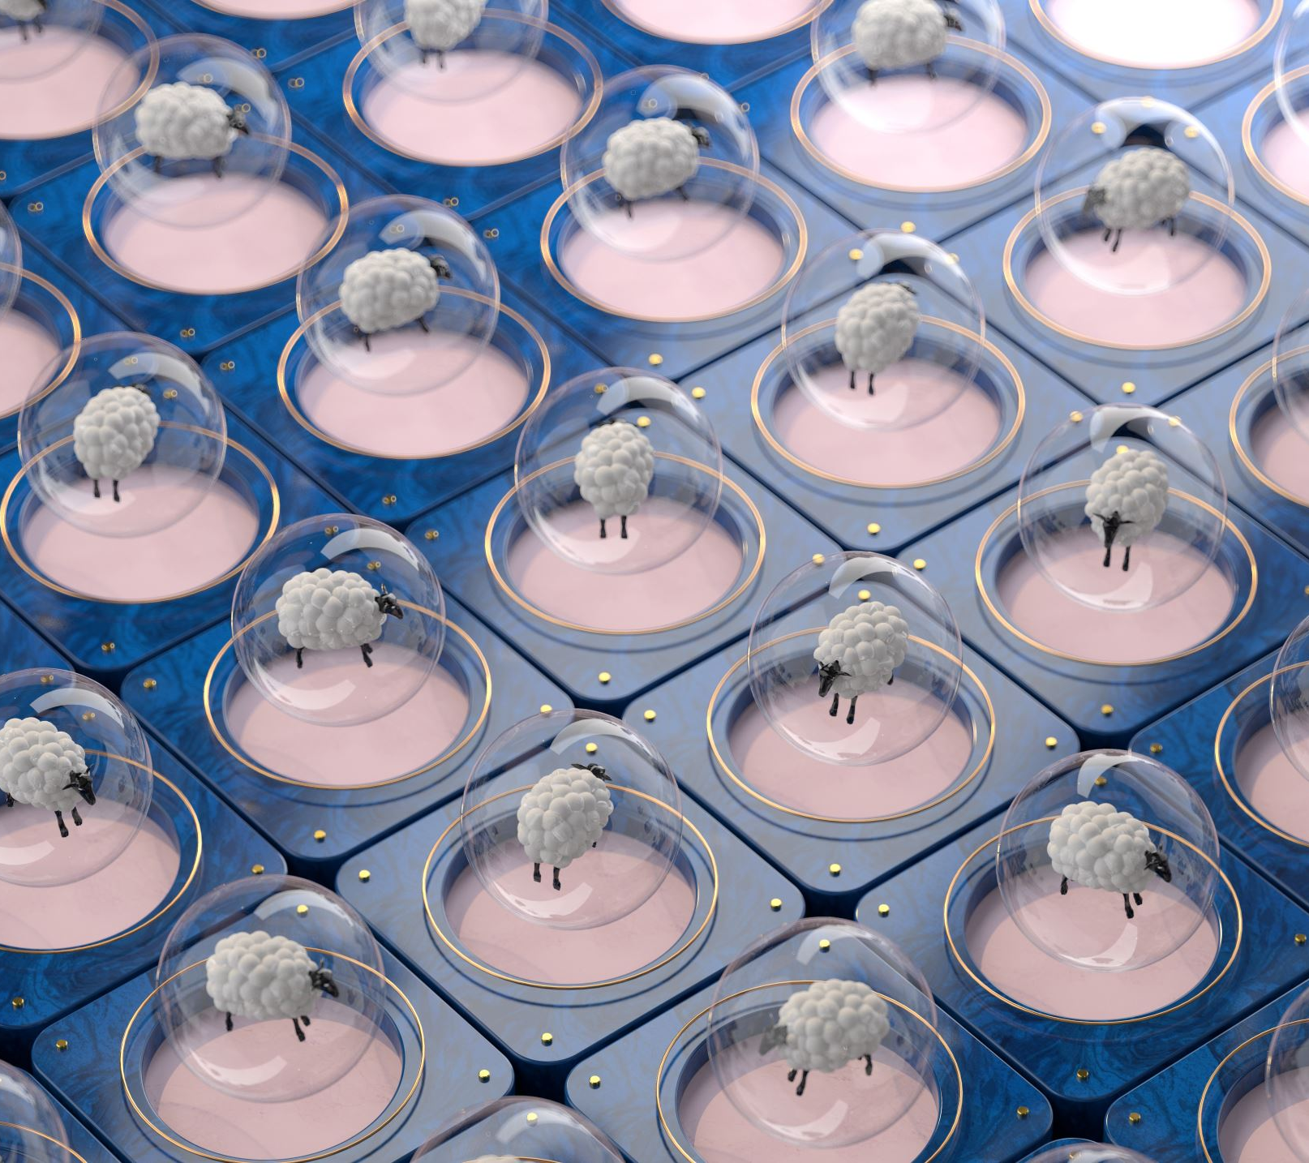
Radiation Interactions with Matter
RT4220 – Lecture #8
Kedree Proffitt
WSU
10/07/2025

Slide 2
Review of Radiation
Two types of Radiation:
Charged Particles
Alpha, Beta+, Beta-, Protons
Electromagnetic Radiation
X-ray, Gamma
Particles interact with matter to shed energy, eventually thermalize and typically join atoms
Most of the energy lost by particle is heat, ionizations are much less, but very relevant biologically

Slide 3
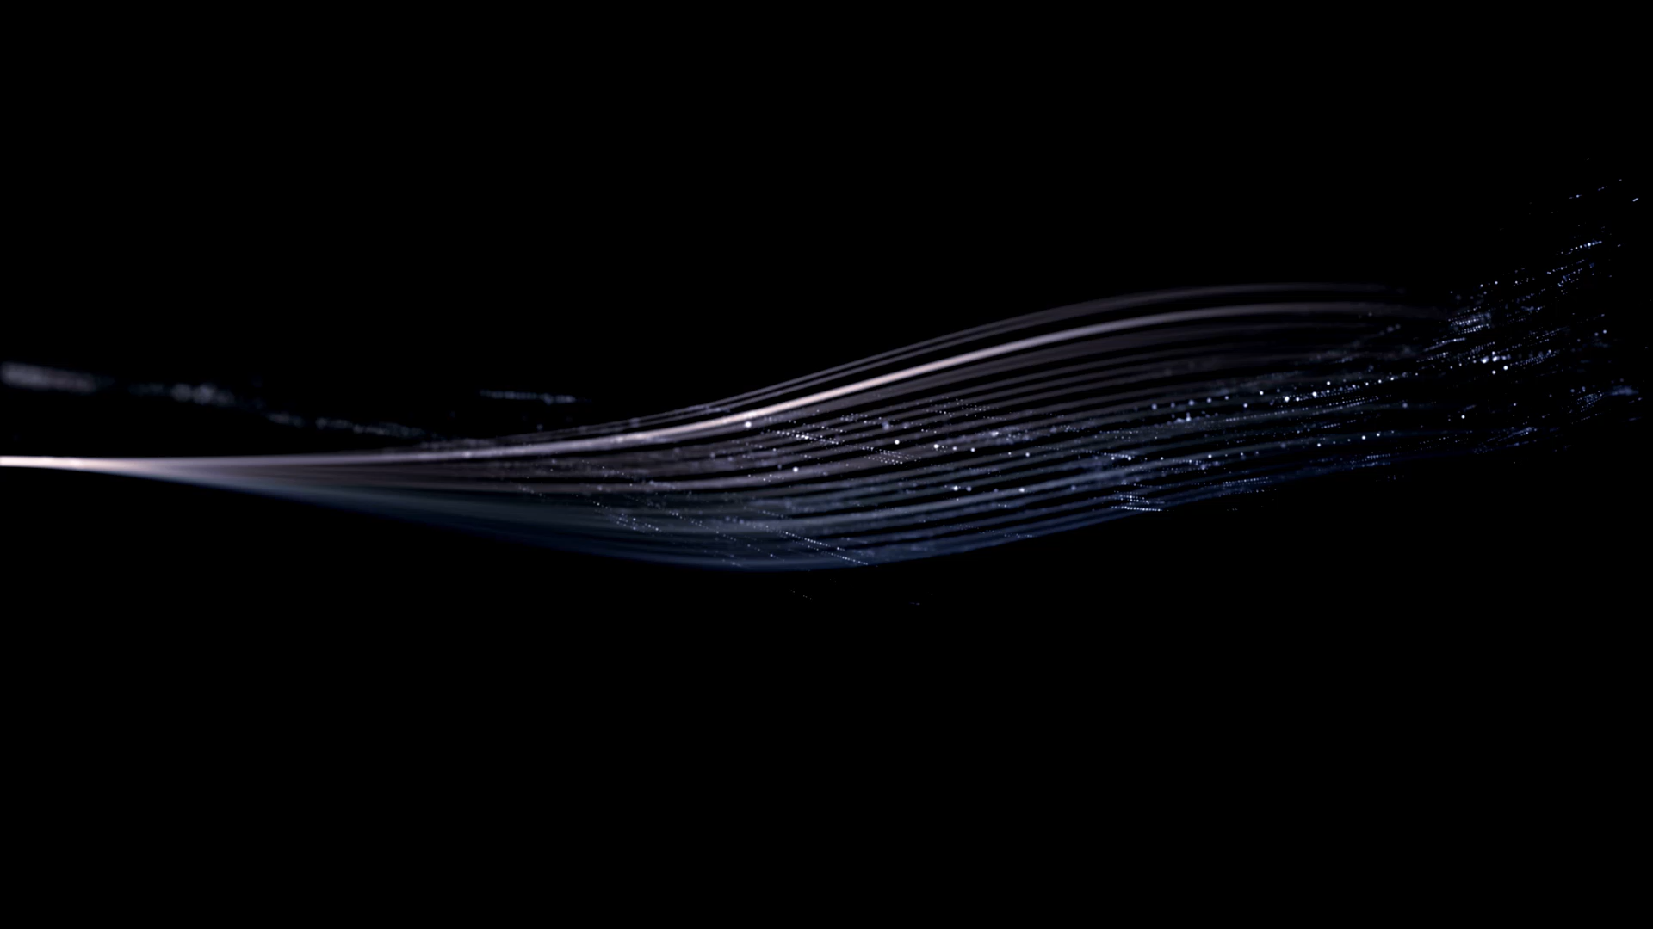
Charged Particles Interactions
Alphas, betas, protons, oh my~

Slide 4
Modes of Charged Particle Interaction
Excitation of the Incident Atom (Thermalization)
Ever throw a ball underwater?
Direct Collision with Electrons (Ionization)
Biological damage and potential Auger
Direct Collision with Nucleus (Nuclear Reaction/Bremsstrahlung)
You love this one! High energy gamma production!

Slide 5
Charged Particle Thermalization
Charged particle interacts with electron clouds at a distance, causing vibrations and giving off infrared
Slow burn novella
Any energy lost in this way is inconsequential to us
Eventually, charged particle slows down to Brownian Motion status, harmless

Slide 6
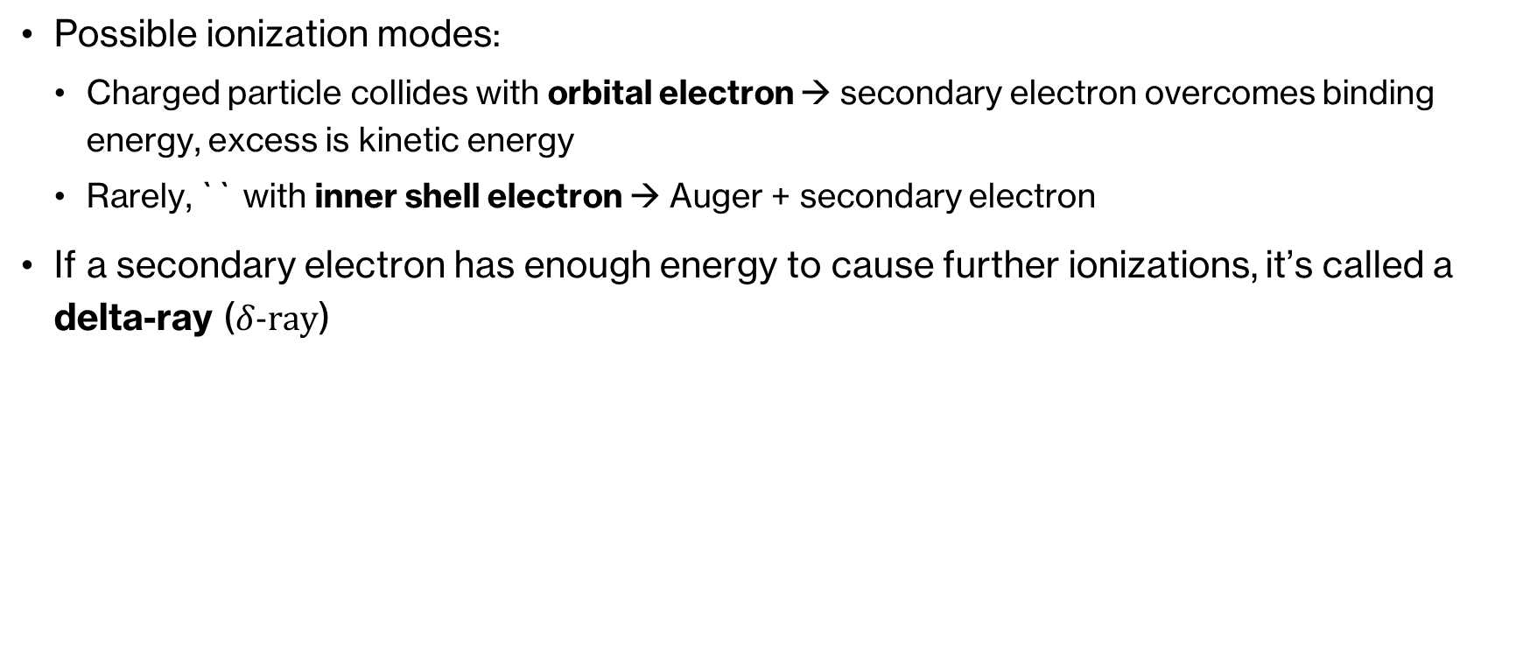
Charged Particle Ionization
Possible ionization modes:
Charged particle collides with orbital electron → secondary electron overcomes binding energy, excess is kinetic energy
Rarely, `` with inner shell electron → Auger + secondary electron
If a secondary electron has enough energy to cause further ionizations, it’s called a delta-ray ($δ-ray$)

Slide 7
Charged Particle Nuclear Interaction
If a charged particle has high enough energy (say, alpha particle), it can penetrate the nucleus and start a nuclear reaction
More likely, especially for electrons, particle deflects from the nucleus
Particle rapidly accelerates (slows down, changes direction) → Bremsstrahlung!

Slide 8
Bremsstrahlung
German: “Braking Radiation” (like a car, vroom vroom, das auto)
Hard and Fast acceleration of charged particle results in possibly high energy gamma
Energy of gamma is a spectrum (has a maximum and average ITS NEVER ZERO)
Angle of deflection determines energy of the photons
Slight deflection → low-energy photons
Great deflection → high-energy photons

Slide 9
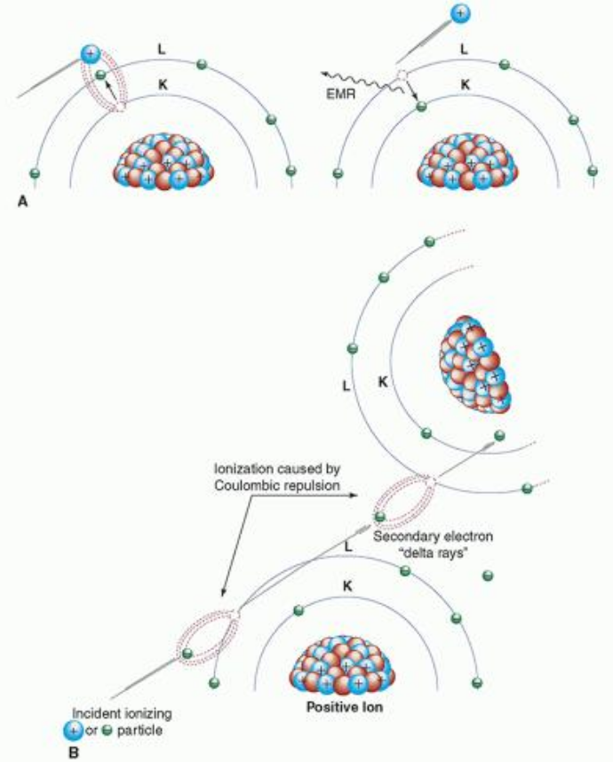
Excitation VS Ionization and Delta-Ray
Excitation: Far encounter between charged particle and shell electron results in low energy deexcitation photon
Ionization: Close encounter between charged particle and shell electron pulls/pushes electron away from atom (now called secondary electron)
If secondary electron can ionize other atoms, it is called a delta-ray

Slide 10
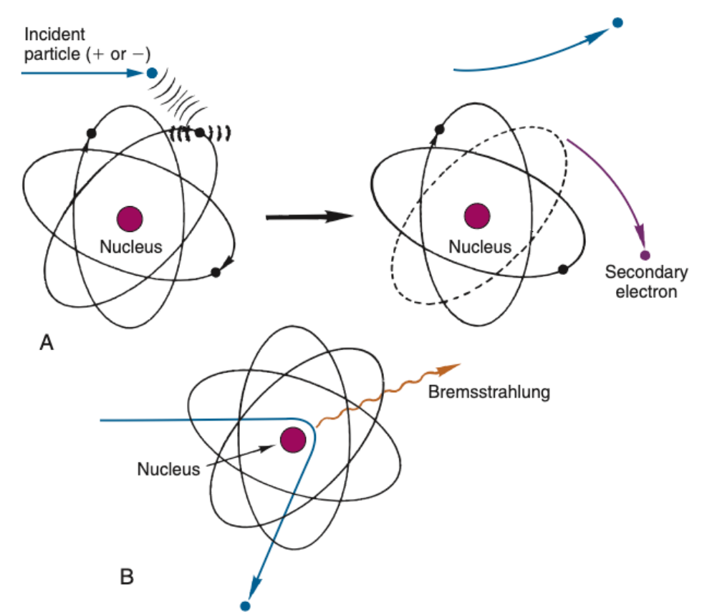
Ionization VS Bremsstrahlung
A. Ionization: charged particle bumps off an electron, origin of electron determines Auger/Char. Rad., secondary electron can be a delta-ray
B. Bremsstrahlung: near nuclear interaction causes rapid acceleration which gives off photons, these photons can wreak havoc

Slide 11
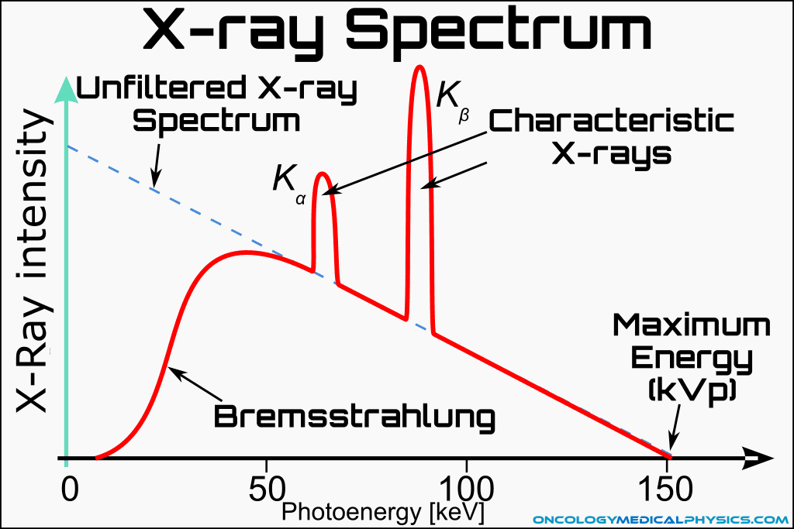
Bremsstrahlung Spectrum

Slide 12
Collisional and Radiation Losses
Collisional Losses: Energy deposited typically stays very close to the source
Excitation and Ionization
Generally greater than radiation losses
Radiation Losses: Energy can travel very far
Bremsstrahlung
Increases greatly for high-energy charged particles and high atomic number targets (Z)

Slide 13
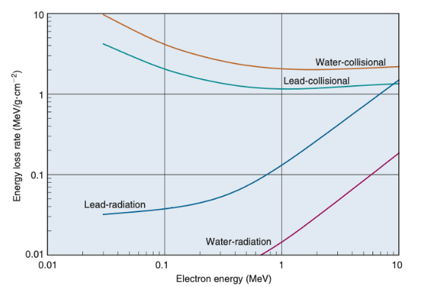
Collisional VS Radiation Losses
First Line (Yellow): Low-Z target, collisional losses
Second Line (Green): High-Z target, collisional losses
Third Line (Blue): High-Z target, radiation losses
Fourth Line (Magenta): Low-Z target, radiation losses
Notice log-scale, flipped behavior between Coll. And Rad. losses

Slide 14
Charged Particle Tracks in Matter
Charged particles leave behind wake of ionized atoms and secondary electrons about 100 um wide due to delta-rays
Path of particle varies greatly by particle weight and charge:
Alpha particles travel straight due to very few bremsstrahlung and relative size difference compared to electrons, slow, continuous loss of energy
Beta particles travel tortuous path due to them being the same size as the secondary electrons and bremsstrahlung, catastrophic events are typical
Speed of particles with the same kinetic energy varies greatly:
4 MeV KE alpha travels 10% of the speed of massless things
1 MeV KE beta travels 90% of the speed of massless things
Density of ionization wake differs greatly:
Alpha particles lose energy much faster → dense wake
Beta particles lose energy much slower → less dense wake

Slide 15
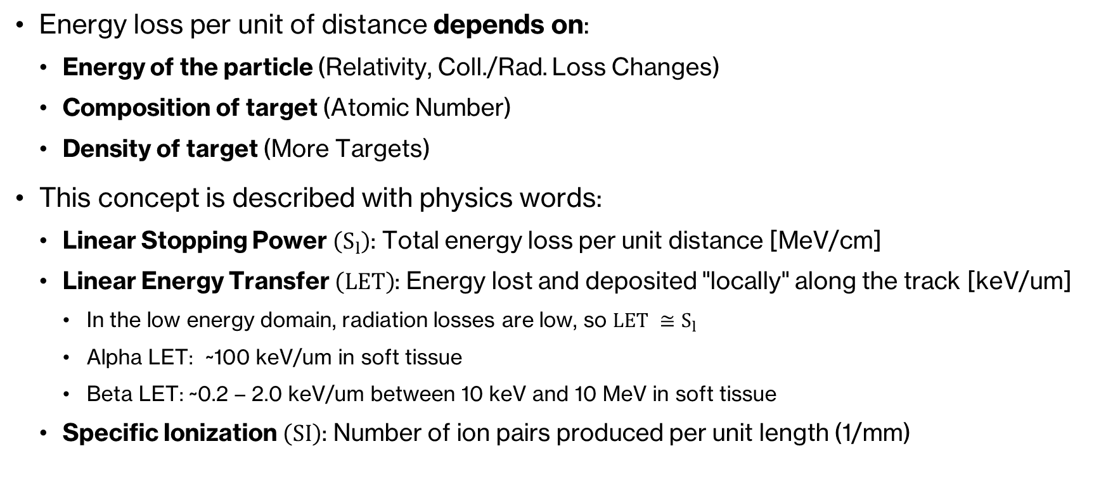
Energy Loss Dependence
Energy loss per unit of distance depends on:
Energy of the particle (Relativity, Coll./Rad. Loss Changes)
Composition of target (Atomic Number)
Density of target (More Targets)
This concept is described with physics words:
Linear Stopping Power $\left(S_{l}\right)$: Total energy loss per unit distance [MeV/cm]
Linear Energy Transfer $\left(LET\right)$: Energy lost and deposited "locally" along the track [keV/um]
In the low energy domain, radiation losses are low, so $LET ≅S_{l}$
Alpha LET: ~100 keV/um in soft tissue
Beta LET: ~0.2 – 2.0 keV/um between 10 keV and 10 MeV in soft tissue
Specific Ionization $\left(SI\right)$: Number of ion pairs produced per unit length (1/mm)

Slide 16
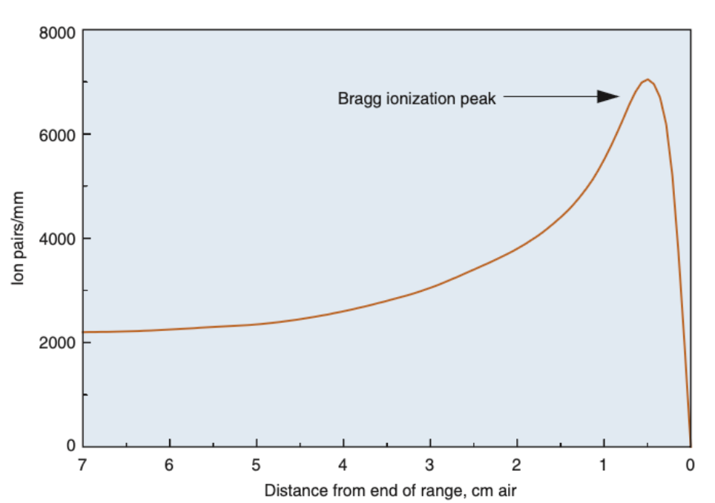
Bragg Peak
As a charged particle slows down, its ionization density increases
Heavy charged particles peak very sharply near the end of their track
Differs greatly from beta particles and photons

Slide 17
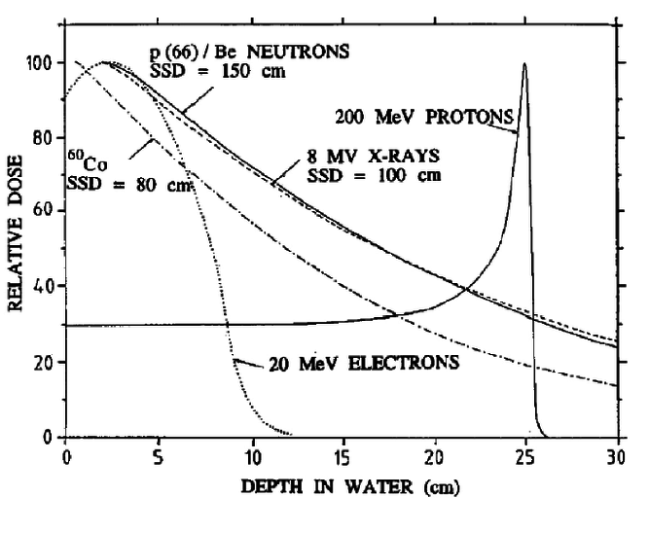
Energy Deposition by Particle Type
Electrons: Peak, then quickly deposit their energy, not nearly as quick as protons and very long compared to alphas (not shown)
Protons: Constant energy transfer, slow burn, LET increases sharply, BRAGG PEAK, no more protons
X-rays (Photons): Log-style very slow energy deposition, approaches infinity depth
Neutrons: VERY SIMILAR to photons

Slide 18
Use Cases for Different Particle Types
Alphas: Not super useful, cannot penetrate beyond dead skin layer, if only we could get it inside the body and deposit it in the tumor! (THERANOSTICS)
Betas: Somewhat localized energy deposition, but cannot penetrate deep into the body without serious harm to normal tissue
Protons: Extremely localized energy deposition, but prohibitively expensive and requires utmost precision (forget treating lungs!)
Photons: Energy deposition is very-well studied, can penetrate through the whole body to reach deep tumors
Neutrons: Ask Dr. Jay Burmeister, Karmanos was KING of the Neutron World under his stewardship, now defunct globally, afaik

Slide 19
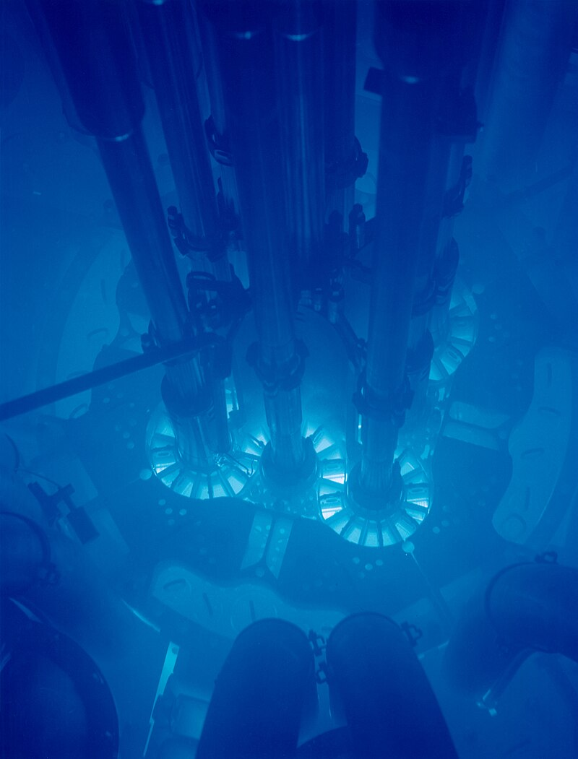
Fun Side Note: Cherenkov Radiation “Chair-ing K‘o’f”
A VERY fast charged particle slows down in a medium (say, water), thus emitting photons; if the particle travels faster than the photons propagate through the medium, then constructive interference occurs which allows us to see the radiation with our own eyes. The charged particle is literally traveling faster than the light can propagate in the water creating a “sonic-boom” like effect, but for light.
Very Cool!

Slide 20

Electromagnetic Radiation Interactions
Oh, that’s gammas and x-rays!

Slide 21
Photon Interactions with Matter
ONLY 5, NO MORE NO LESS:
Photoelectric Effect
Compton Scattering
Pair Production
Coherent Scattering
Photonuclear Effect

Slide 22
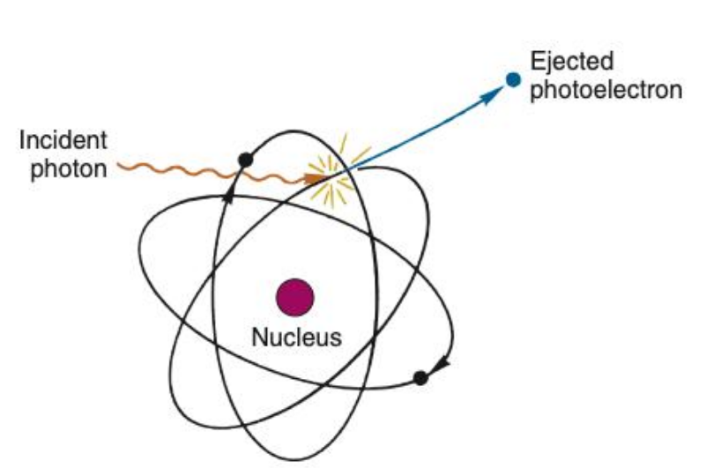
Photoelectric Effect
Photon is absorbed by a shell electron
Photoelectron is emitted with kinetic energy
Thus, a photon has set in motion a charged particle, which will do stuff from the previous section
KE = Photon energy – Binding Energy

Slide 23
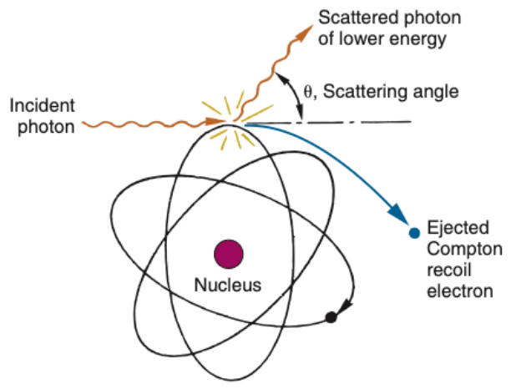
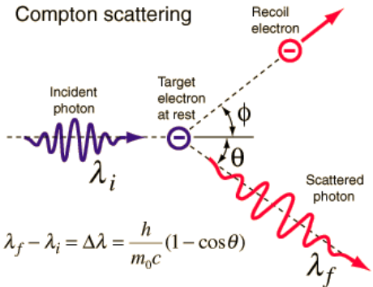
Compton Scattering
Photon is scattered by a shell electron
Energy is split between the Compton electron and photon
Photon continues, interacts more
Charged particle is set in motion

Slide 24
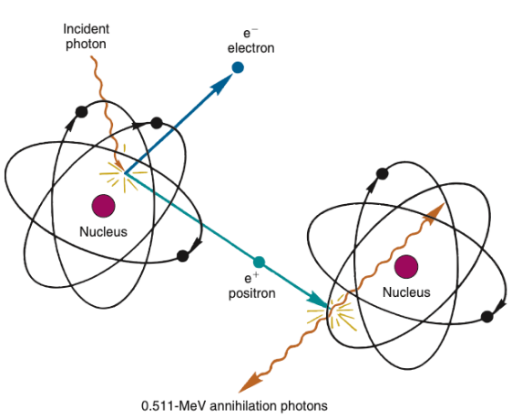
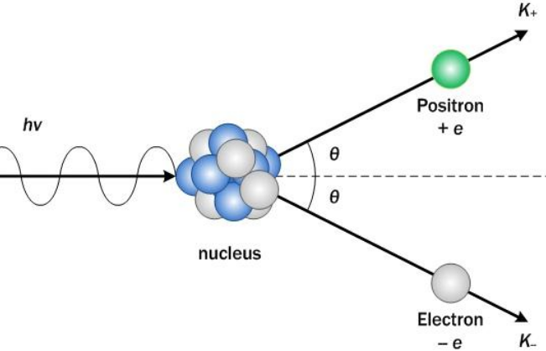
Pair Production
Photon consumed by nucleus, creating positron/electron pair
Pair typically travel in opposite directions, do not interact with each other
Positron later annihilates into two opposed photons
MINIMUM ENERGY REQUIREMENT OF 1.022 MeV

Slide 25
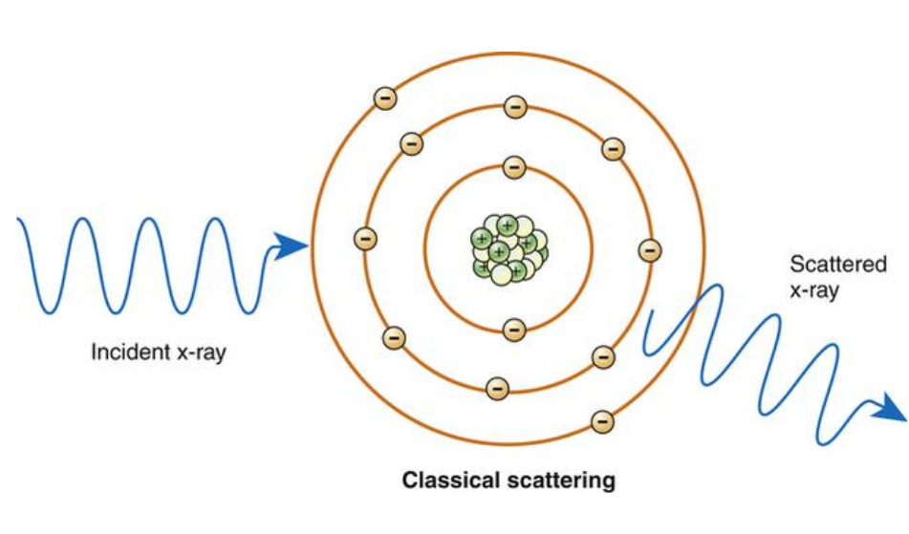
Coherent Scattering
Common misconception: Rayleigh scattering and coherent scattering are the same thing
Reality: Coherent scattering has two modes, Rayleigh and Thompson Scattering
More Reality: Nobody cares in medical physics because there is no energy exchange
Rayleigh Scattering: Whole atom vibrates, scattering very low energy photon
Thompson Scattering: Free electron scatters photon

Slide 26
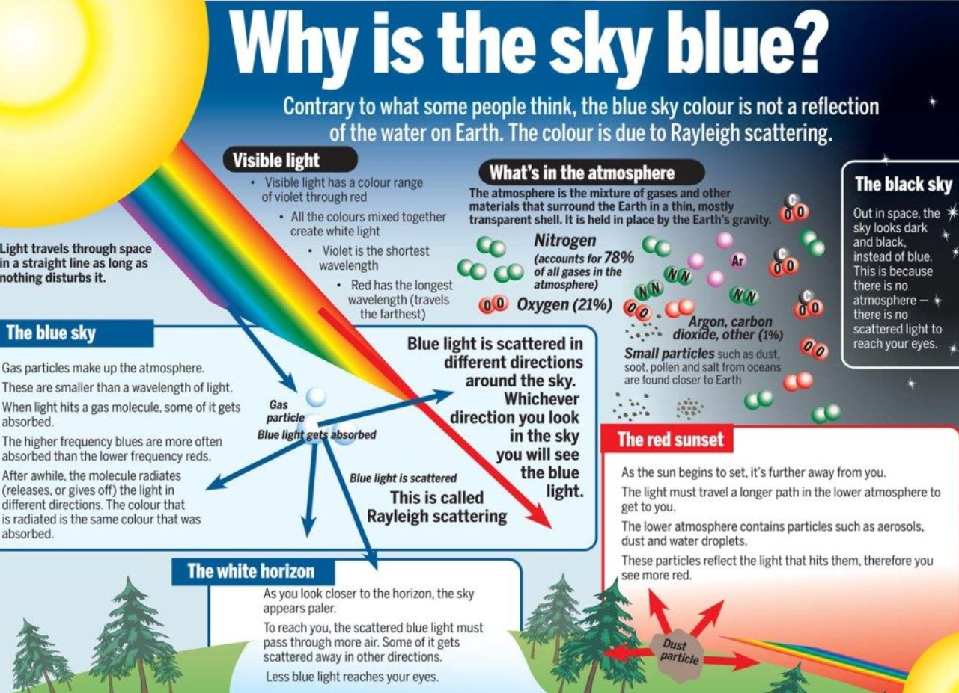

Slide 27
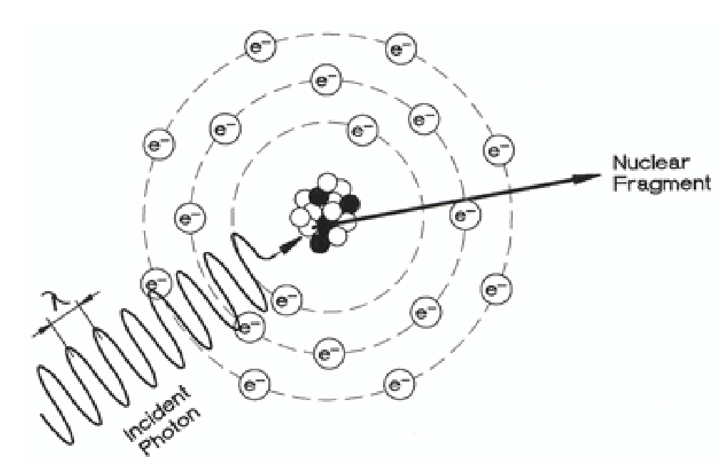
Photonuclear Effect
Photon consumed by a nucleus, causing excited nuclear state
Nucleus emits neutron or proton (nuclear fragment)
Proton does little
Slow Neutron can ACTIVATE other materials, making them radioactive
Only relevant at VERY high energies (10 MeV)
Very important for shielding concerns

Slide 28
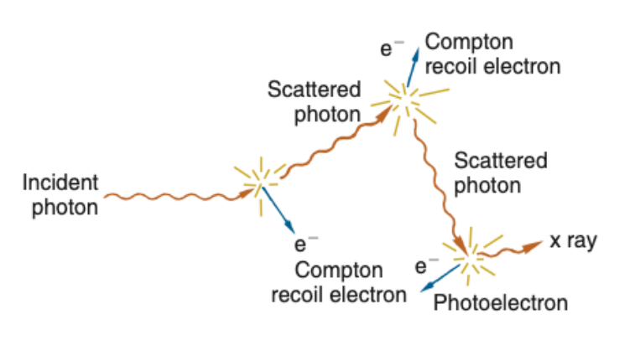
Electromagnetic Radiation Track
Photons can undergo many interactions, thousands and thousands, or just one!
All 5 modes are possible if the energy is high enough, but definitely not probable!
Probability of each mode is highly dependent on target composition, particle energy, density, etc.
Particle is erratic, typically forward focused, but spreads out and can even go significantly backward!
Compton scattering is by far the most prevalent for 99% of what we do.

Slide 29
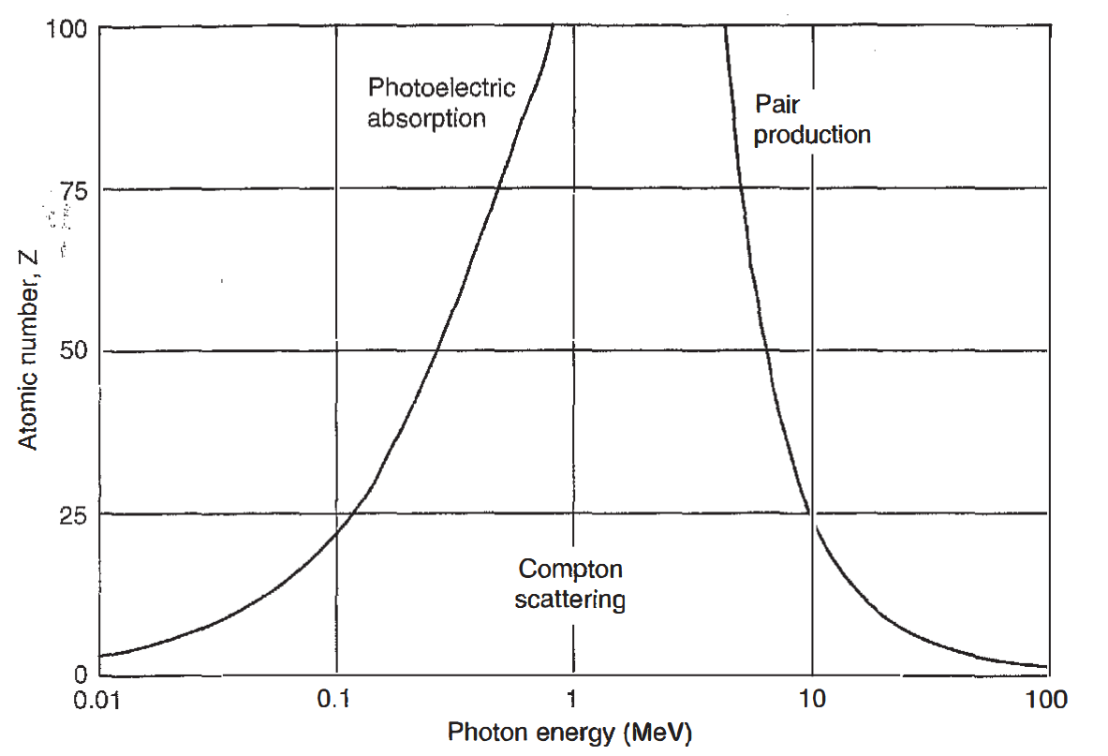
Dominant Interaction Domains
Ask a medical physicist student their favorite graph, 9/10 will say this one!
Shows the dominant domains of each of the three relevant photon interactions as a function of photon energy and atomic number.

Slide 30
Some Numbers (Humble Bragging)
I programmed a Monte Carlo Simulation of photon interactions
It followed EVERY photon, from start to finish, simulating physics
100,000 6X photons set in motion nearly 1,000,000 electrons in 2,281,157 interaction events
In reality, these electrons would set in motion even more electrons (delta-rays)!
I just simplified it by doing a CSDA approximation (thermalizing in a straight line constantly)
Hundreds of lines of code, and too many hours.

Slide 31
